Slide 1
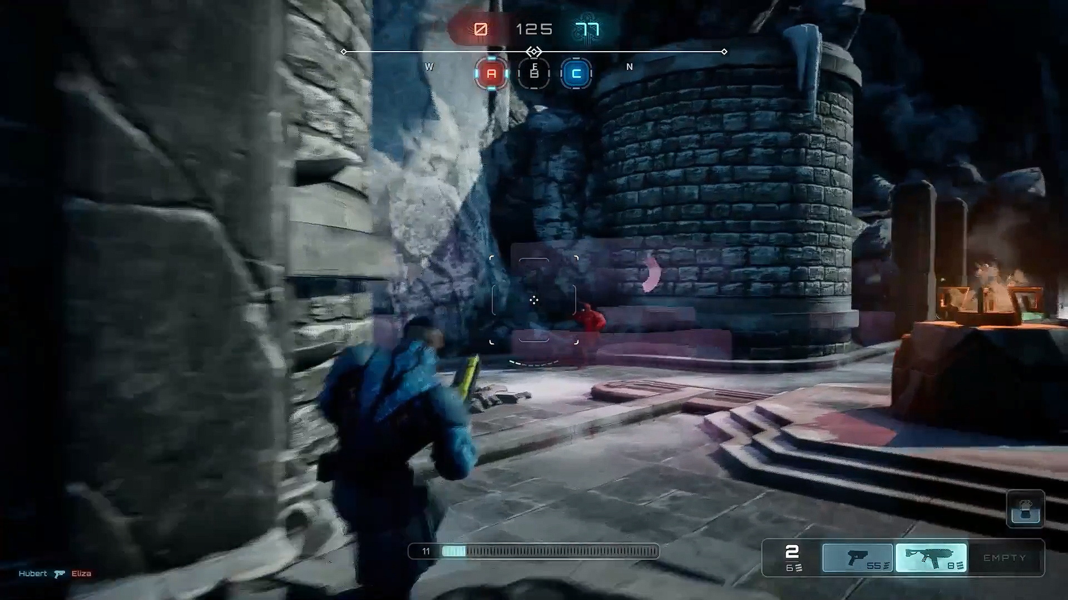
Axel
Third-Person Shooter Game

Slide 2
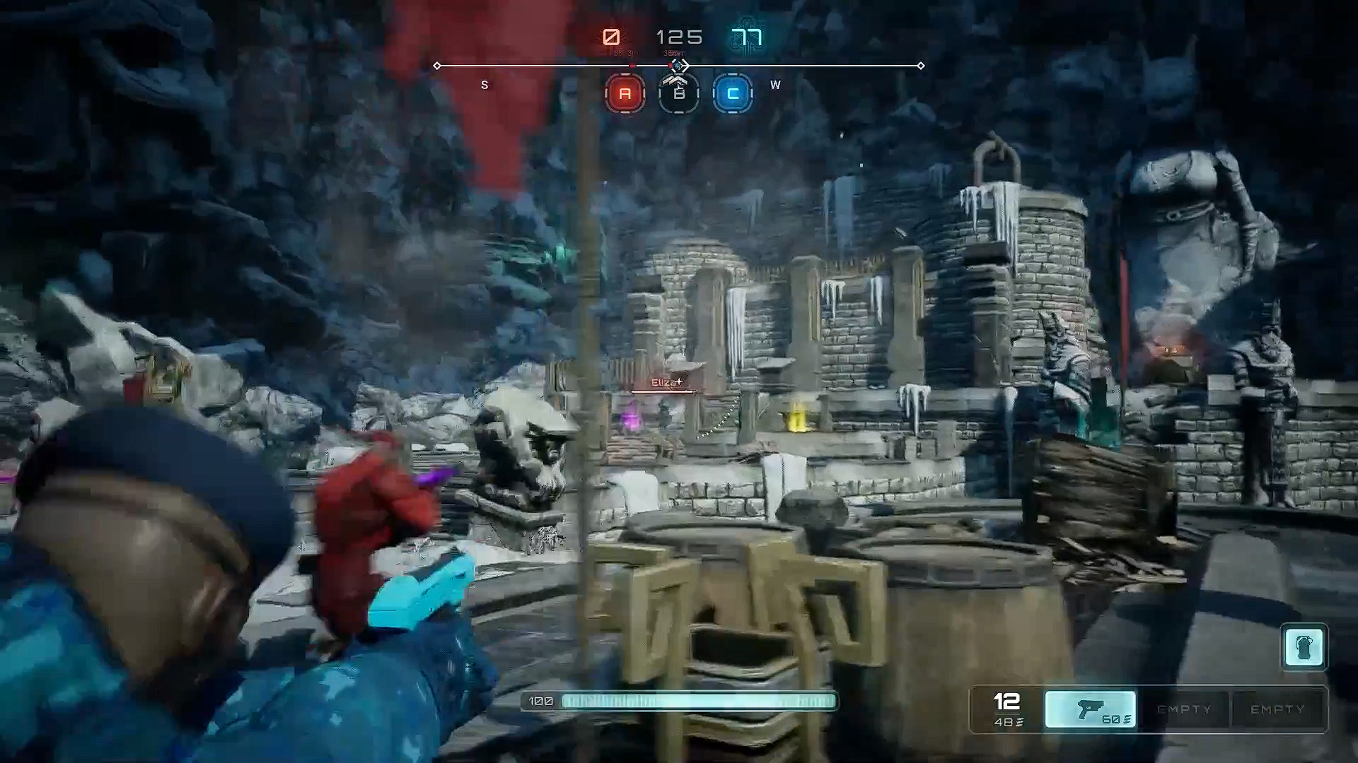
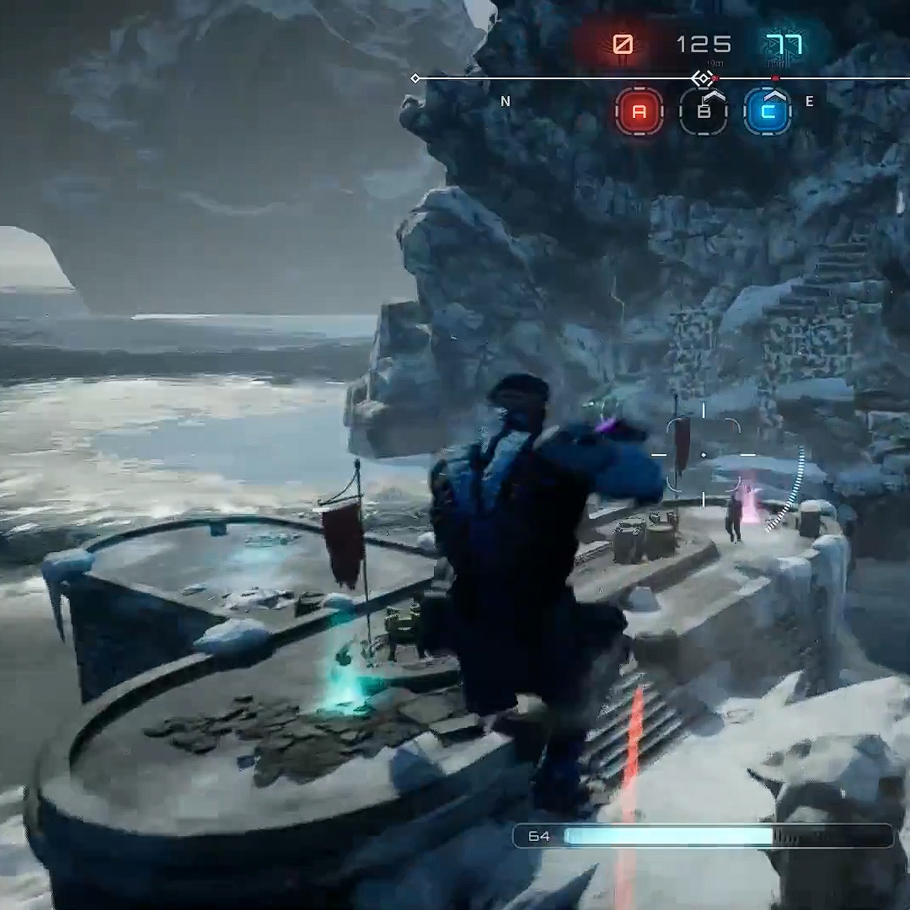
Index
Introduction
Storyline & Gameplay
Features
Graphics and Sound
Conclusion

Slide 3
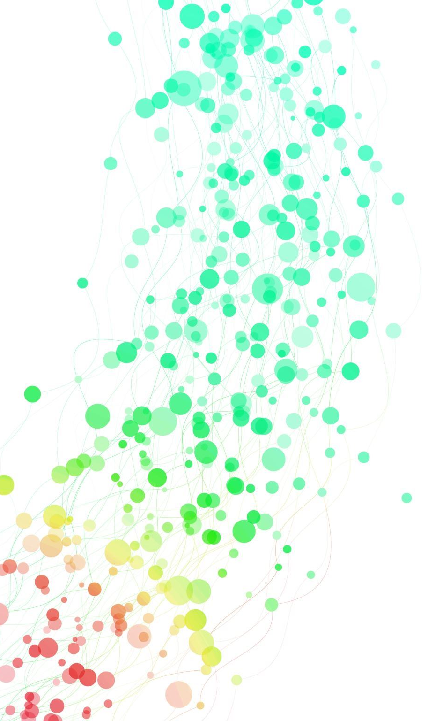
introduction
Welcome to the world of Axel, a high-octane third-person shooter game that will put your skills to the test. In this game, you'll take on the role of a skilled fighter, battling your way through a dangerous world filled with enemies and obstacles. While our game is ready and with slight modification it will release on 16 March, 2023.

Slide 4
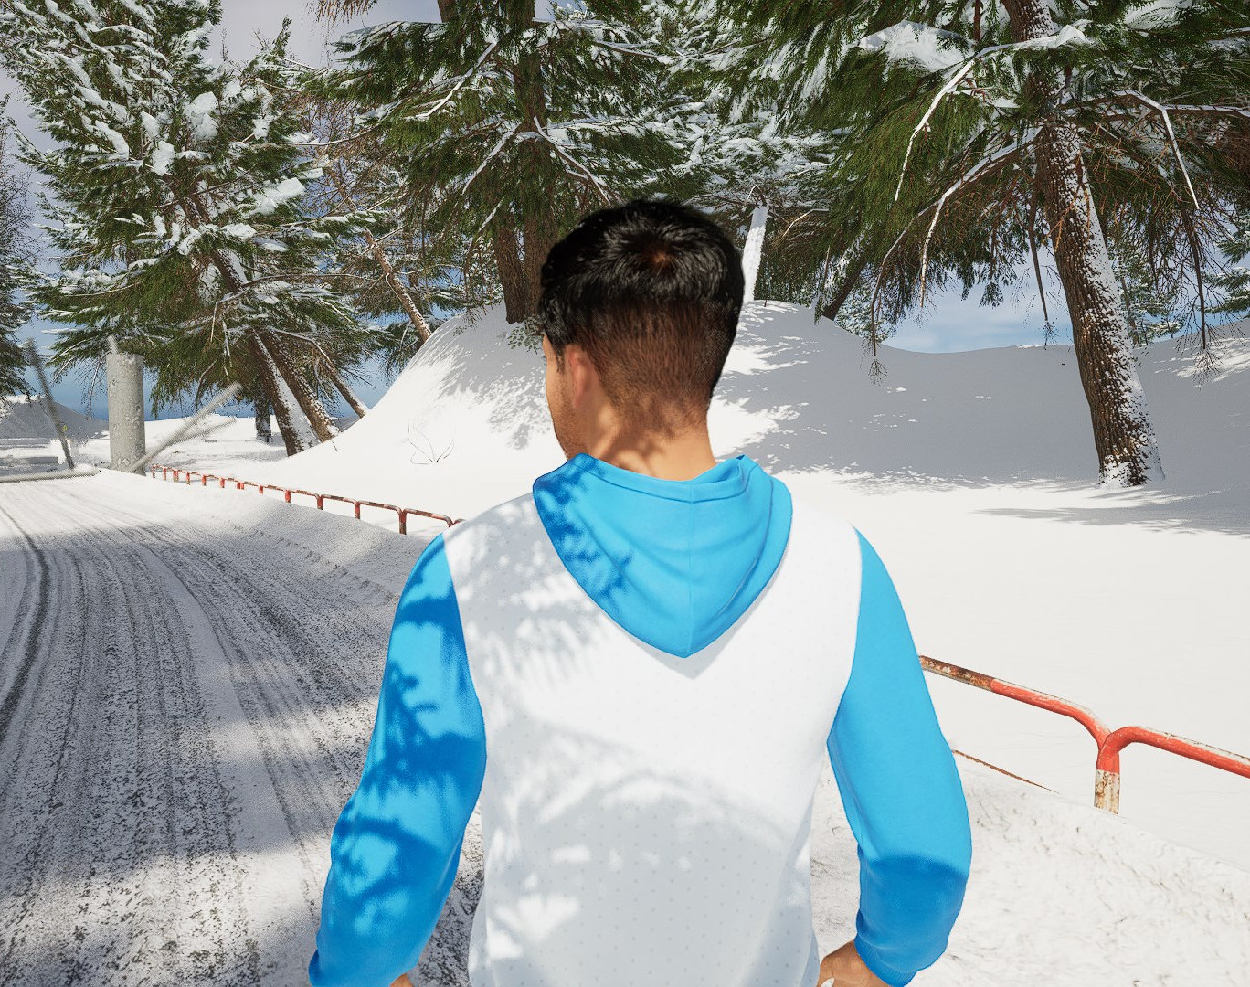
What is a third-person shooter?
Unlike first-person shooters, where the player sees through the eyes of the character, third-person shooters provide a wider view of the game world, with the camera following the character's movements from behind or over the shoulder.

Slide 5
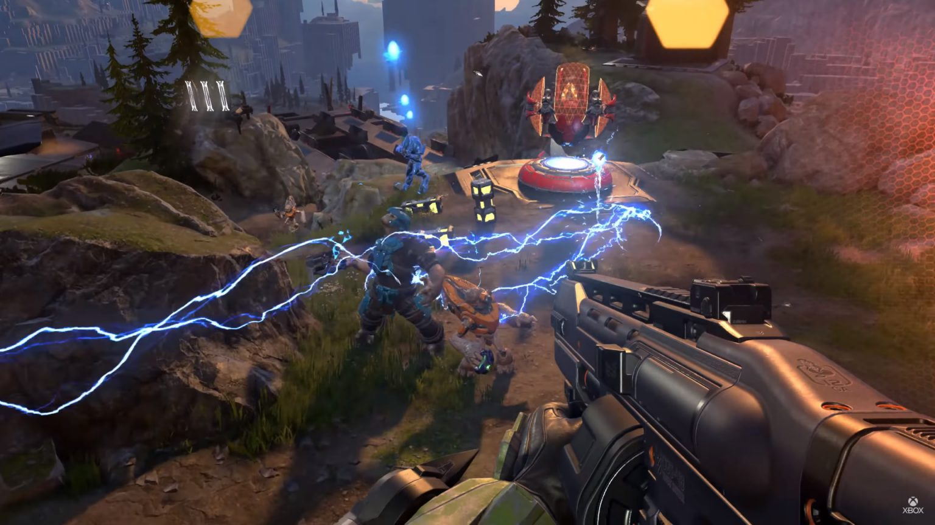
Storyline
Gameplay &

Slide 6
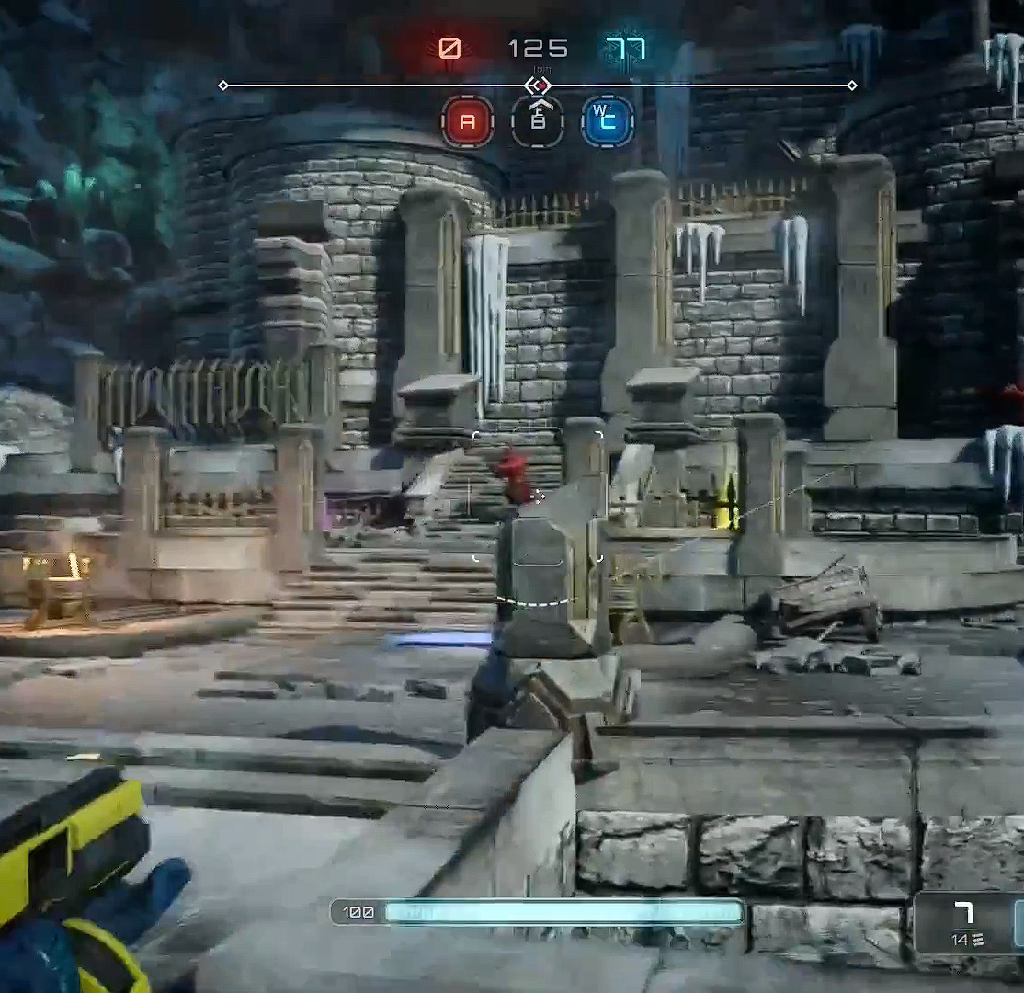
Storyline
Axel takes place in a post-apocalyptic world where players must fight to survive against a variety of enemies.
The game's storyline is rich and engaging, with unexpected plot twists and intense action sequences.
Players will encounter a diverse cast of characters, each with their own motivations and backstory.
Axel features both online and offline modes, with the latter allowing players to play against bots.

Slide 7
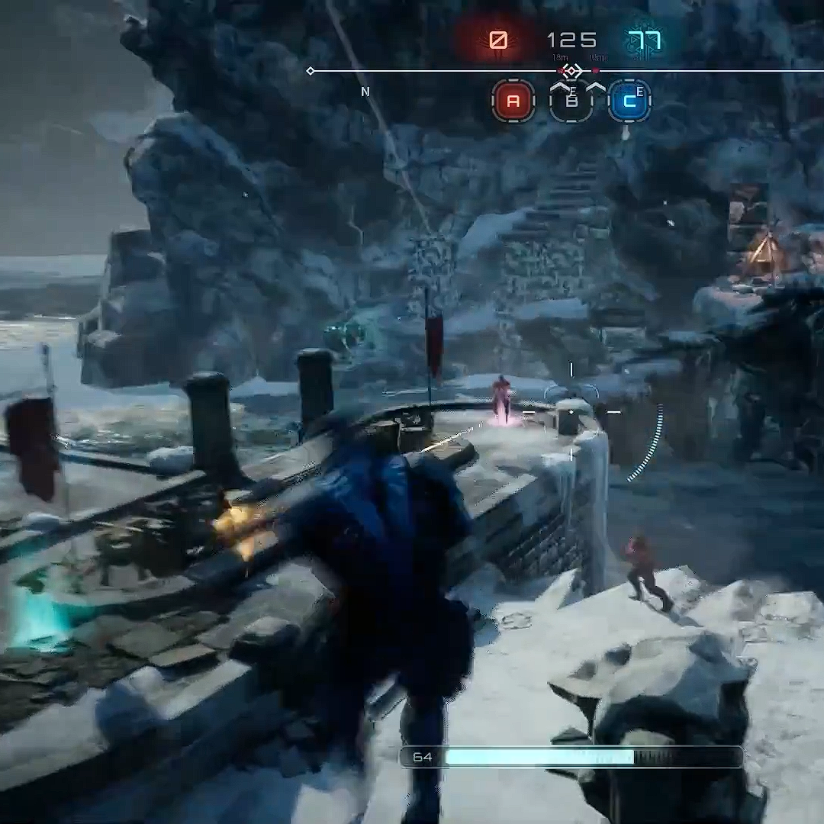
Gameplay
Axel's gameplay is fast-paced and action-packed, with a variety of different modes to keep players engaged.
The game's controls are intuitive, making it easy for new players to jump in and start playing.
Axel features a diverse range of weapons and equipment, each with its own strengths and weaknesses.
The game also features a unique real-world character system, which allows players to scan their faces and create a character that looks like them.
Axel multiplayer modes include both competitive and cooperative gameplay, with a variety of maps and environments to keep things interesting.

Slide 8
Features
Uniqueness
Axel offers players a range of unique features that set it apart from other third-person shooter games.
Real-world character system
Players can scan their faces and create a character that looks like them, adding a personal touch to the gameplay experience. But to do this players have to contract developer.
Immersive graphics and sound design
The game's top-notch graphics and sound design create an immersive world that players will want to spend hours exploring.
Multiplayer modes
Offline mode
Axel offers both competitive and cooperative multiplayer modes, with a variety of maps and environments to keep things interesting.
Players can play against bots in offline mode, offering a challenging experience for those who prefer to play alone.

Slide 9
Video games can have several benefits for Bangladesh. Here are a few reasons why:
Economic development:
The video game industry is a multibillion-dollar industry worldwide, and it can contribute to economic development in Bangladesh by creating job opportunities for game developers, designers, and other related professions.
Entertainment:
Video games can provide entertainment and relaxation for people of all ages, particularly during times of stress or social isolation.
Education:
Innovation:
Tourism:
Developing video games requires creativity and innovation, and this can contribute to the growth of a culture of innovation in Bangladesh
Video games can be designed to showcase Bangladesh's rich cultural heritage and attractions, promoting tourism and generating revenue for the country.
Video games can be designed to help children and adults learn new skills and knowledge, such as problem-solving, critical thinking, and language learning

Slide 10
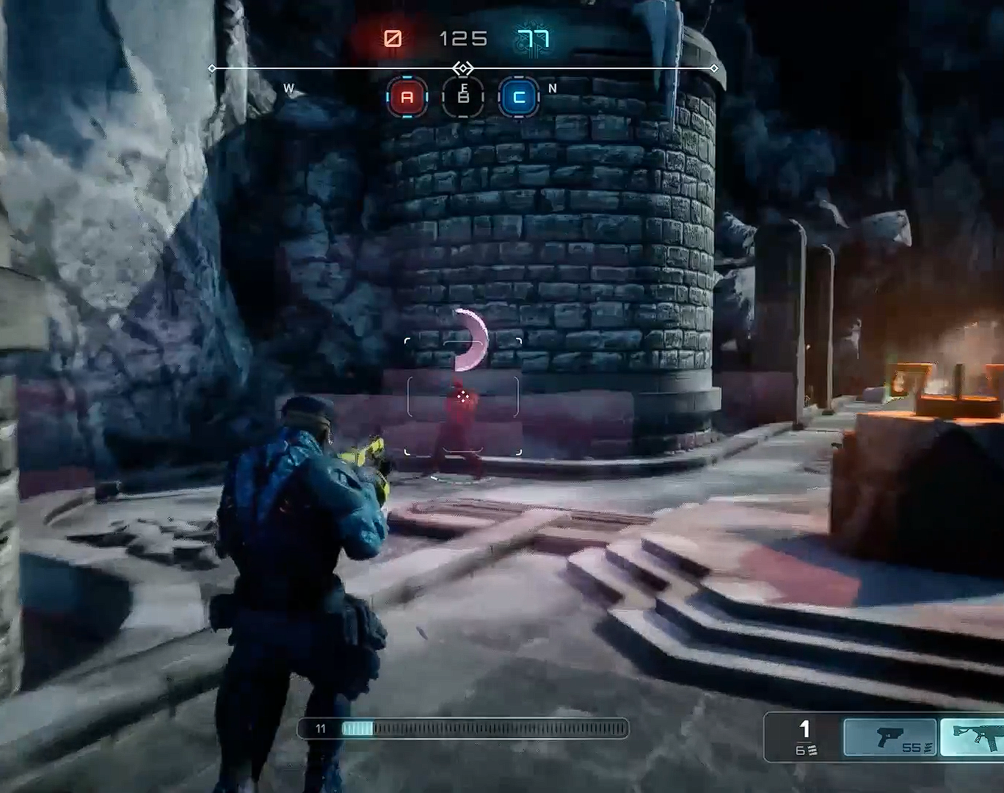
Summary
Axel's unique features make it a standout third-person shooter game. From the real-world character system to the diverse weapons and equipment, Axel offers players a personalized and engaging gameplay experience. With both online and offline modes, immersive graphics and sound design, and regular updates and events, Axel is a must-play for fans of the genre.

Slide 11
Thank you
Name: Shakil Anower Samrat
Email: samratkubdas@gmail.com
Website: www.softsasi.com

